Slide 1


<Purnima>
<25/01/24>

Slide 2
Outline
Executive Summary
Introduction
Methodology
Results
Conclusion
Appendix
2

Slide 3
Executive Summary
Summary of methodologies
Data collection: SpaceX-API + Webscraping of SpaceX Wikipedia page
Data Wrangling: Missing Values replaced by mean values
Exploratory Data Analysis:
Analyze outcome by orbit type
Analyze outcome by payload mass and booster versions with SQL
Visual Analysis with charts by payload mass, time, orbit type and launch site
Visual Analysis with map by site
Interactive Dashboard: Analysis by Site, Payload and booster version
Predictive Analysis Using Classification: Logistic Regression, SVM, Decision Tree, KNN
Summary of all results
Launch success rate increases over time
Higher success rate for higher orbits
Higher success rate for higher payload mass
Low success rate for booster versions v1.0, v1.1, high success rate for FT, B4, B5
Higher success rate for Kennedy Space center and recent starts at Cape Canaveral
3

Slide 4
Introduction
Project background and context
SpaceX advertises low-cost Falcon 9 rocket launches (average of $62m vs. $165m of competitors
This success is because of the reusability of the first stage
Problems we want to find answers
If we can determine if the first stage will land, we can determine the cost of a launch.
This information can be used if an alternate company wants to bid against SpaceX for a rocket launch.
4

Slide 5

Section 1
5

Slide 6
Methodology
Executive Summary
Data collection methodology:
SpaceX-API
Webscraping of SpaceX Wikipedia page
Perform data wrangling
Missing Values replaced by mean values (Payload Mass)
Perform exploratory data analysis (EDA) using visualization and SQL
Analyze outcome by orbit type
Analyze outcome by payload mass and booster versions with SQL
Visual Analysis with charts by payload mass, time, orbit type and launch site
Perform interactive visual analytics using Folium and Plotly Dash
Visual Analysis with map by site
Interactive Dashboard: Analysis by Site, Payload and booster version
Perform predictive analysis using classification models
Logistic Regression, SVM, Decision Tree, KNN
Parameter Tuning with Grid Search
6

Slide 7
Data Collection
SpaceX REST API
RESTful Interface
Get Core Data
Get Booster Version
Get Launch Site Data
Get Payload Data
Webscraping of SpaceX Wikipedia Page
HTML Requests (HTTP-Get)
Python / BeautifulSoup (Package for Webscraping)
Extract Column Names from HTML table header
Data Collection Jupyter Notebook
7

Slide 8
Data Collection – SpaceX API
Send Get Request to SpaceX API interface website
Parse data into Pandas dataframe
Extract data with specific functions for:
Core data
Launch Site Data
Payload Mass
Booster Version
Since Data contains other than Falcon 9 data, we filter for Falcon 9 data only
Data Collection (RESTful API)
Convert to Pandas Dataframe
Extract Core Data, Launch Site Data Payload Data Booster Version
Get
Request
Pandas: Filter
Falcon 9
8

Slide 9
Data Collection - Scraping
Send HTTP Request to SpaceX Wikipedia website
Parse data into Pandas dataframe with BeautifulSoup Webscraper
Extract data with find_all method
Store data into Pandas dataframe for further use
Data Collection (Webscraping)
Extract relevant Table Data with find_all
Pandas: Store data into Dataframe
HTTP
Request
Parse Data with
BeautifulSoup

Slide 10
Data Wrangling
Dealing with missing values: The column for payload mass had a handful of missing values. We replaced them with the mean value (standard in Analysis / ML)
Data Wrangling

Slide 11
EDA with Data Visualization
Charts:
Payload mass vs. Flight number vs. Success rate: This shows us the development
of the payload mass and the success rate over time
Launch site vs. Flight number vs. Success rate: This shows us the success rate of
each launch site over time
Launch site vs. Payload mass vs. Success rate: This shows us which payload is best to have success at a specific launch site
Orbit type vs. Success rate: This can give us a hint which orbit types have the highest
success rates
Orbit type vs. Flight number vs. Success rate: This shows us the development of orbit
types over time
Orbit type vs. Payload mass vs. Success rate: Shows us the success rate for specific orbit type / payload mass clusters
Success rate vs. Year: Shows the success development over time
Data Exploration

Slide 12
EDA with SQL
SQL queries
Extract a list of all launch sites
Display 5 records where launch sites begin with the string 'CCA'
Display the total payload mass carried by boosters launched by NASA (CRS)
Display average payload mass carried by booster version F9 v1.1
List the date when the first successful landing outcome in ground pad was achieved
List the names of the boosters which have success in drone ship and have payload mass greater than 4000 but less than 6000
List the total number of successful and failure mission outcomes
List the names of the booster_versions which carried the maximum payload mass
List the failed landing_outcomes in drone ship, their booster versions, and launch site names for in year 2015
Rank the count of landing outcomes (such as Failure (drone ship) or Success (ground pad)) between the date 2010-06-04 and 2017-03-20, in descending order
Data Analysis with SQL

Slide 13
Build an Interactive Map with Folium
Map Objects
Edged Circles (radius 1000m): Space launch sites
Markers: for labeling all objects
MarkerCluster: for creating a bunch of markers around space launch sites to indicate success (green) or failure (red) of the landing of the rocket's first stage
Lines: Measure the distince between the launch site and the next coast or next city
Interactive Map with Folium

Slide 14
Build a Dashboard with Plotly Dash
Input Elements:
Dropdown list for the launch site (with option to select all)
RangeSlider for selecting the payload mass
Output Elements:
PieChart: for showing the success rate of each launch site, or (if all sites are selected) showing the number of successful landing outcomess
Scatterplot: Show success/failure by payload and booster version
Interactive Dashboard with Plotly

Slide 15
Predictive Analysis (Classification)
Preprocessing
One-Hot-Encoding for Categorical Features
Split data into dependent/independent variables and train/test data
Scale Data with StandardScaler
Model Building for each Method
Logistic Regression
Support Vector Machine
Decision Tree
K-Nearest Neighbor
Optimization
Use Gridsearch for optimizing the models based on their hyperparameters
Evaluation
Use Accuracy of Gridsearch for selecting the best parameter
Use Score to compare each classification method
Machine Learning Prediction

Slide 16
Predictive Analysis (Classification)
Feature Engineering for Categorical Features
Split Data into Dependent/Inde pendent and Train/Test
Scale Data with StandardScaler
Build Model (LogR, SVM, Decision Tree, KNN
Optimize Hyperparame ters with GridSearch
Display Confusion Matrix
Calculate Accuracy and Score

Slide 17
Results
Exploratory data analysis results
Launch success rate increases over time
Higher success rate for higher orbits
Interactive analytics demo in screenshots
Higher success rate for higher payload mass
Low success rate for booster versions v1.0, v1.1, high success rate for FT, B4, B5
Higher success rate for Kennedy Space center and recent starts at Cape Canaveral
Predictive analysis results
Best prediction results with Logistic Regression and Support Vector Machine
17

Slide 18

Section 2

Slide 19
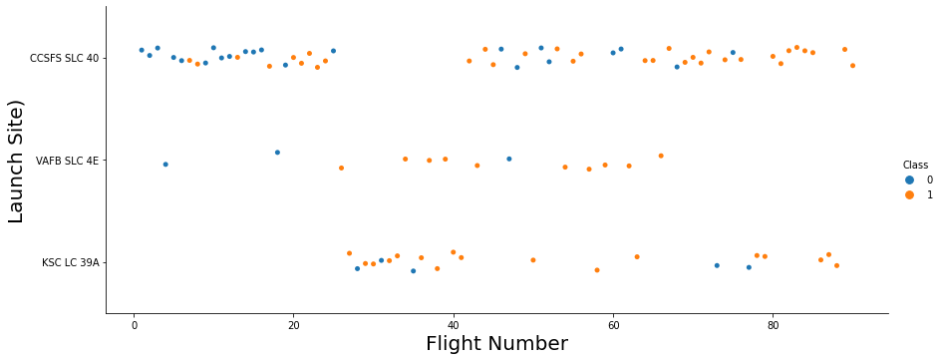
Flight Number vs. Launch Site

Slide 20
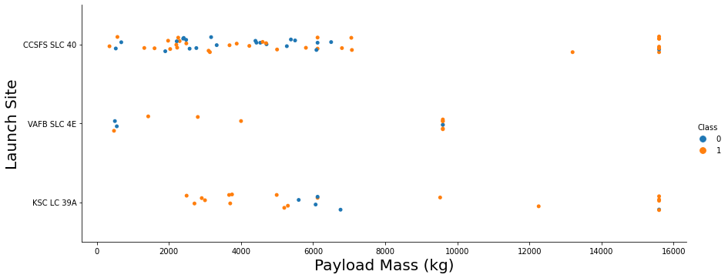
Payload vs. Launch Site

Slide 21
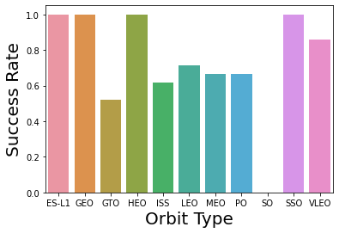
Success Rate vs. Orbit Type
Low Earth Orbits
GTO
ISS
LEO
MEO
PO
VLEO
High Earth Orbits
ES-L1
GEO
HEO
SSO

Slide 22
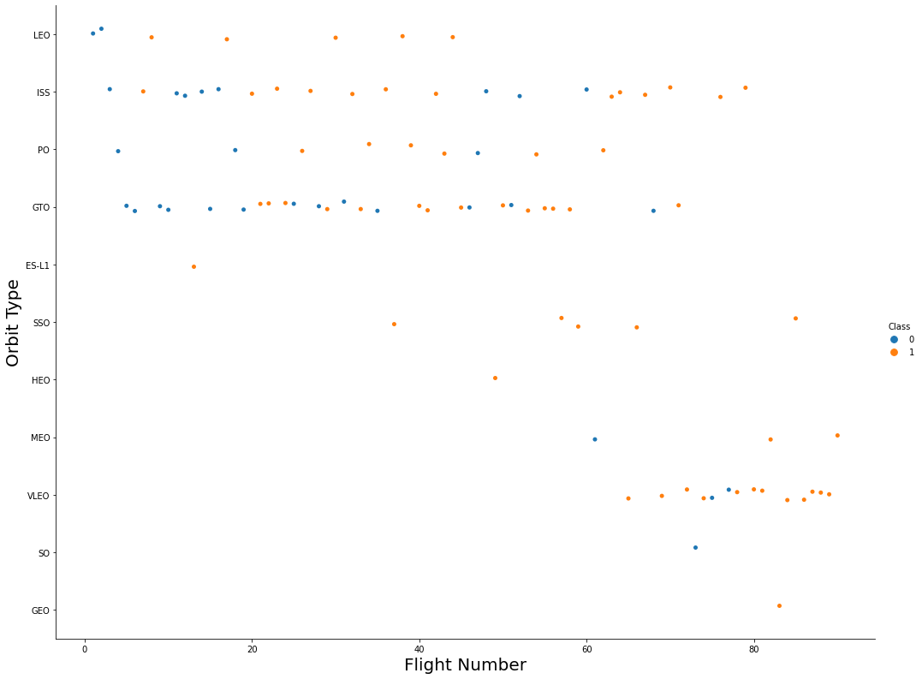
Flight Number vs. Orbit Type
The predominant orbit types have changed over
time. Success rate has increased over time for all orbit types.

Slide 23
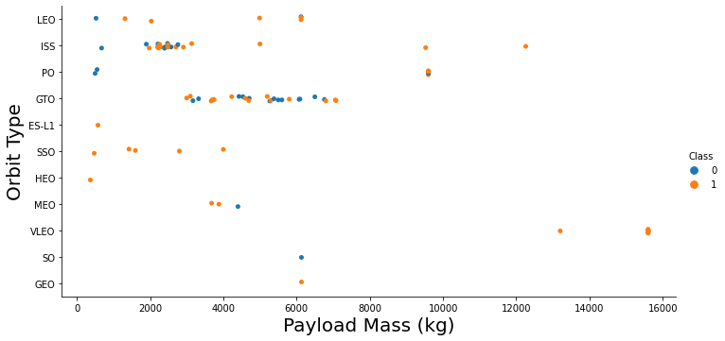
Payload vs. Orbit Type

Slide 24
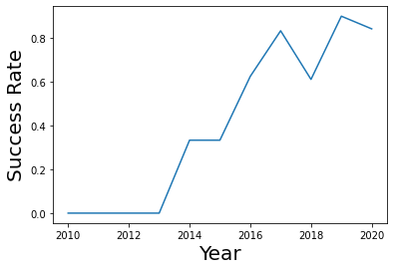
Launch Success Yearly Trend
Launch success has increased over the years

Slide 25
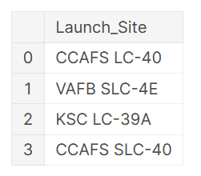
All Launch Site Names
KSC: Kennedy Space Center
CCA...: Cape Canaveral Launch Center
VAFB: Vandenburg Air Force Base

Slide 26
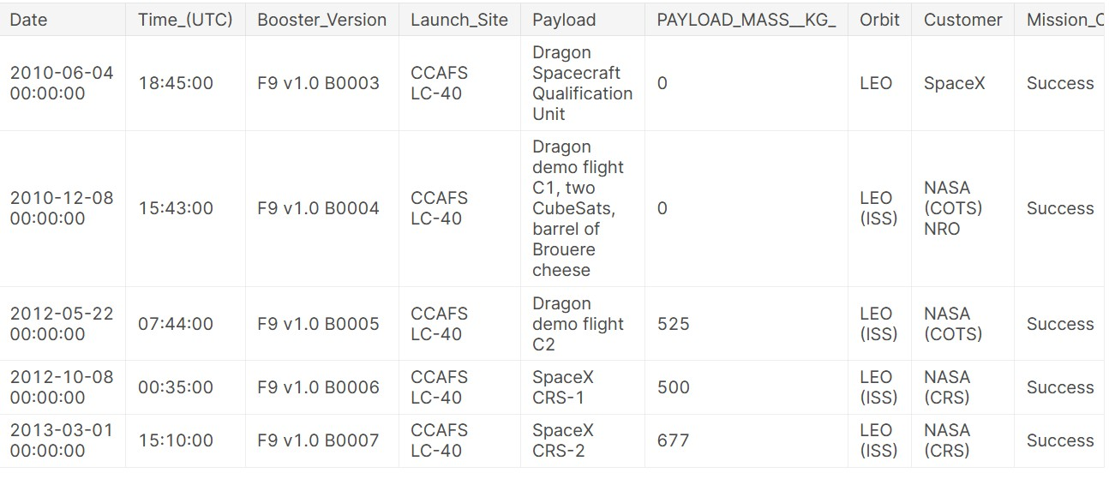
Launch Site Names Begin with 'CCA'
Some sample records for starts at Cape Canaveral Space Center

Slide 27
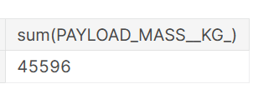
Total Payload Mass
Total payload carried by boosters from NASA

Slide 28
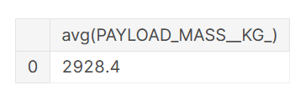
Average Payload Mass by F9 v1.1
Average payload mass carried by booster version F9 v1.1

Slide 29
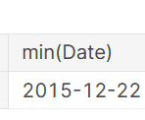
First Successful Ground Landing Date
Date of the first successful landing outcome on ground pad

Slide 30
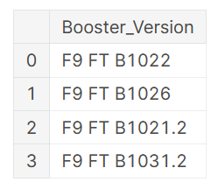
Successful Drone Ship Landing with Payload between 4000 and 6000
Names of boosters which have successfully landed on drone ship and had payload mass greater than 4000 but less than 6000

Slide 31
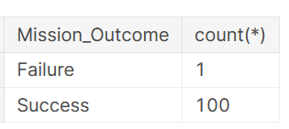
Total Number of Successful and Failure Mission Outcomes
Total number of successful and failure mission outcomes (not to be confused with the outcome of the stage-1 landing)

Slide 32
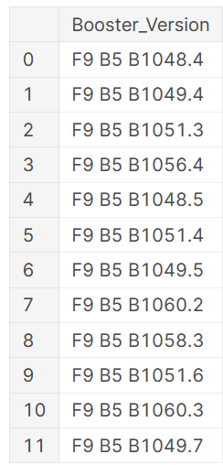
Boosters Carried Maximum Payload
Names of the booster which have carried the maximum payload mass

Slide 33
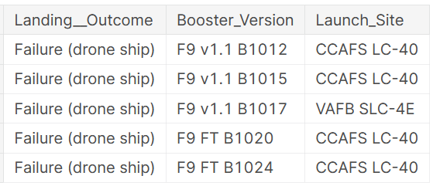
2015 Launch Records
List
of failed landing outcomes in drone ship, their booster versions,
and launch site names for in year 2015

Slide 34
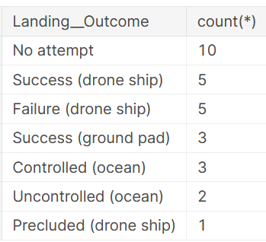
Rank Landing Outcomes Between 2010-06-04 and 2017-03-20
Rank of the count of landing outcomes (such as Failure (drone ship) or Success (ground pad)) between the date 2010-06-04 and 2017-03-20, in descending order

Slide 35

Section 3

Slide 36
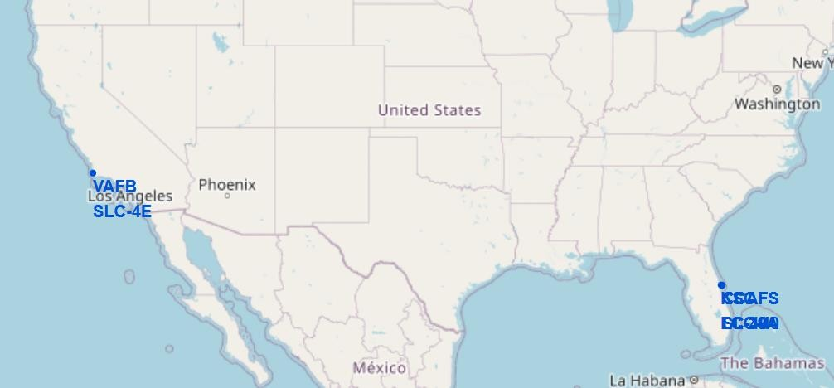
Folium Map: Launch Sites
Launch sites are at the East and West coast, near the southernmost U.S. mainland area, which is Florida and California

Slide 37
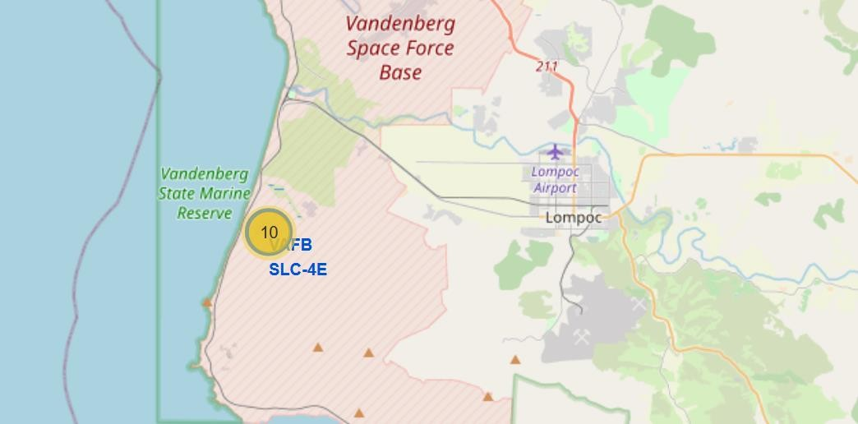
Folium Map: Proximity Vandenburg AFB
Close to the Vandenburg AFB is the town of Lompoc. This might be an issue, if the stage-1 landing cannot be controlled, since rockets would usually start towards Eastern direction

Slide 38
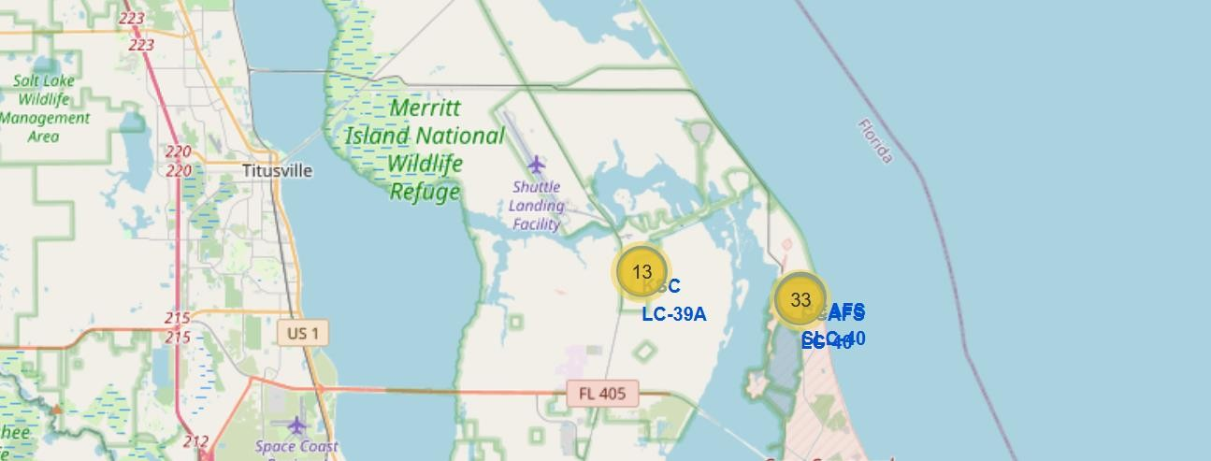
Folium Map: Proximity Kennedy SC / Cape Canaveral
No city towards the Eastern Direction, ideal place for testing rocket launches

Slide 39
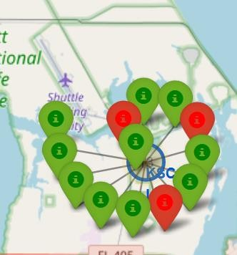
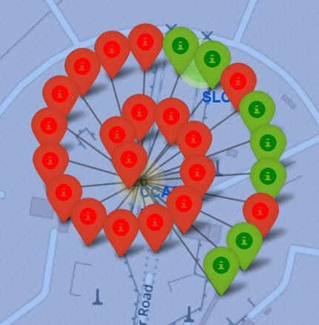
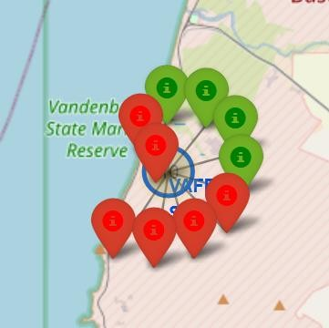
Folium Map: Stage-1 Landing Success by Launch Site
Vandenburg AFB
Kennedy Space Center
Cape Canaveral

Slide 40

Section 4

Slide 41
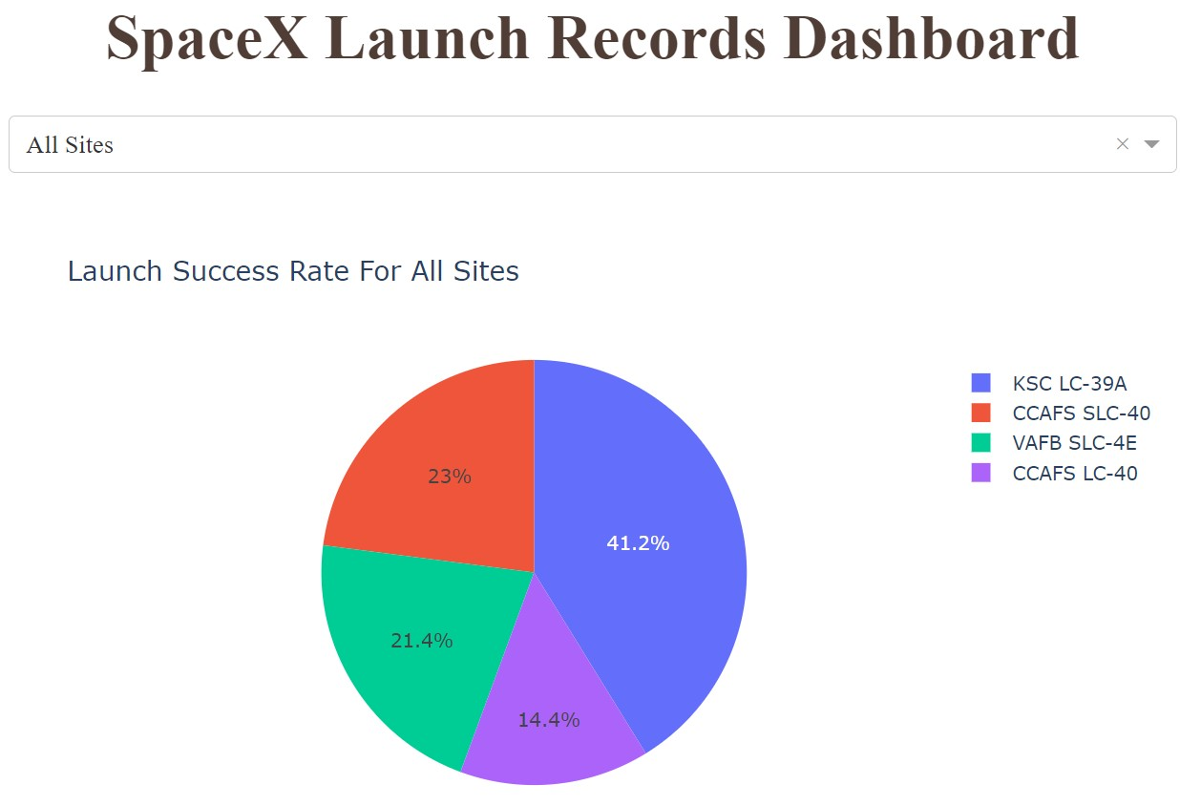
Dashboard: Launch Success Count For All Sites
Kennedy Space Center (KSC LC-39A) hast the most successful stage-1 landings
Vandenberg Air Force Base (VAFB SLC-4E) has the least number of successful stage-1 landings

Slide 42
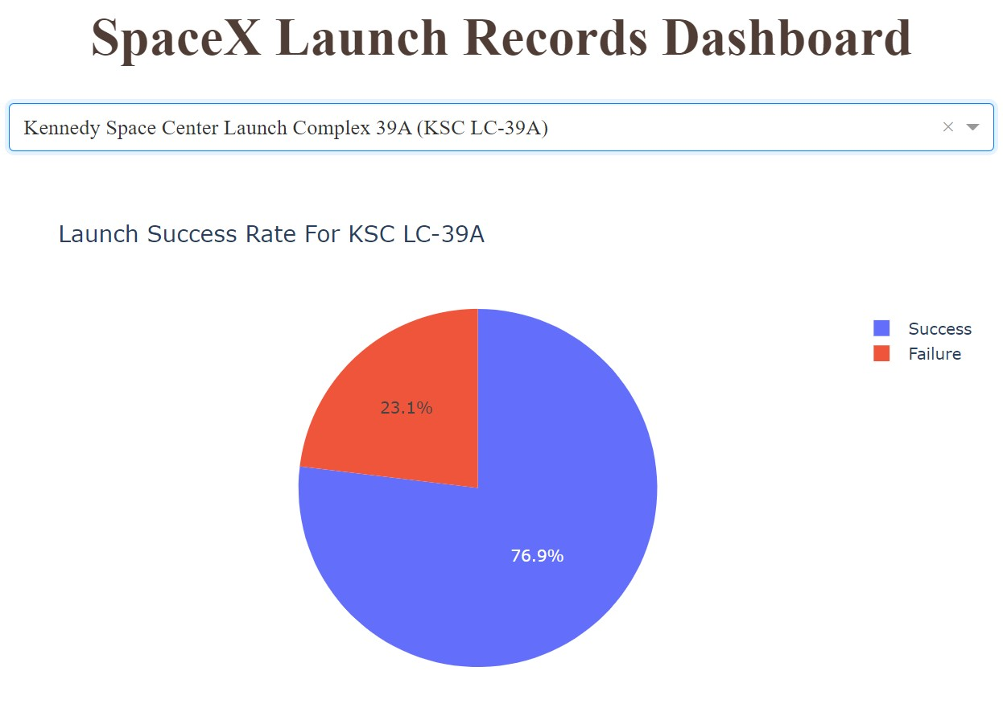
Dashboard: Success Rate Kennedy Space Center
More than 3 of 4 landings have been successful at Kennedy Space Center

Slide 43
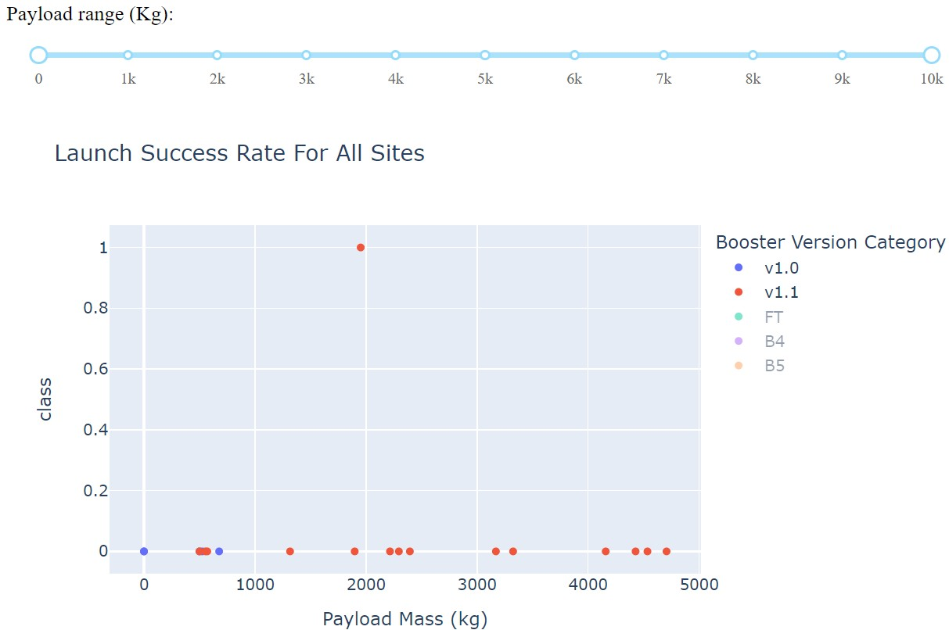
Dashboard: Booster Versions V1.0, V1.1
Success rate forBooster versions v1.0 and v1.1 is quite small in
the payload range to 10000kg

Slide 44
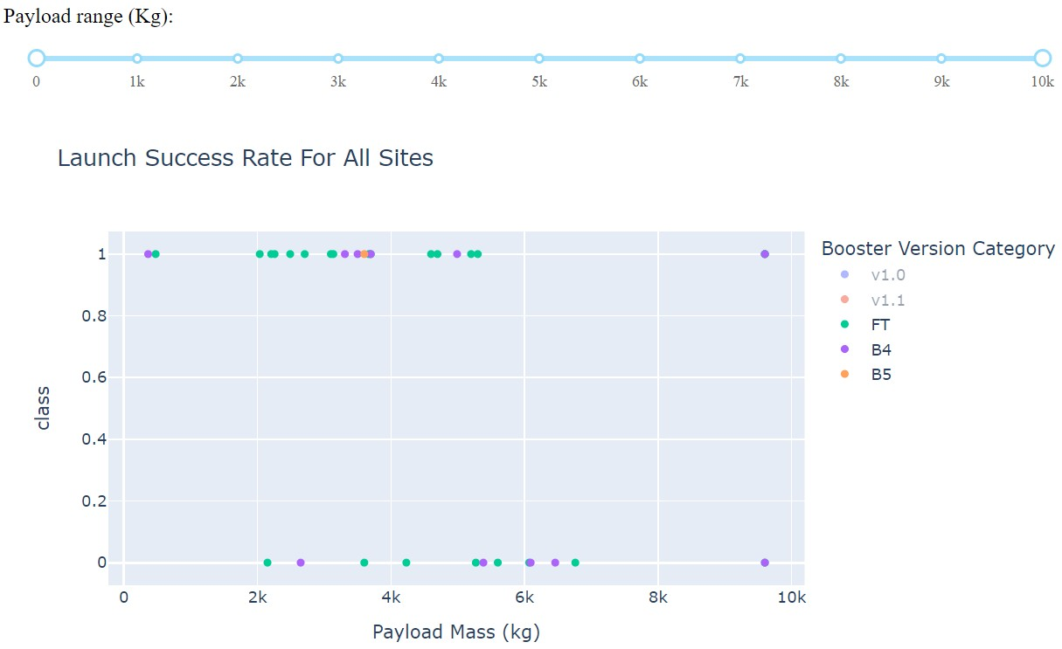
Dashboard: Booster Versions V1.0, V1.1
Success rate forBooster
versions FT, B4 and B5 is better in the payload range to 10000kg

Slide 45

Section 5

Slide 46
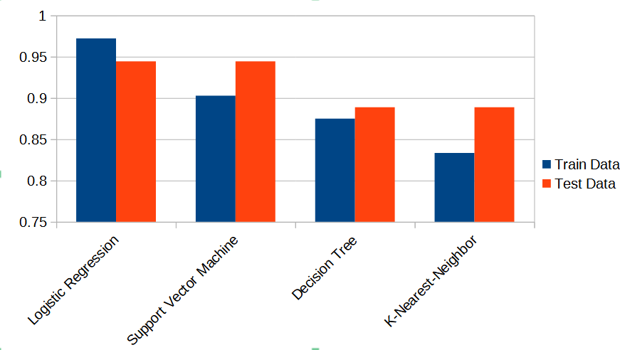
Classification Accuracy
Logistic Regression has the best result for train data
Logistic Regression and Support Vector Machines have the best results on test data

Slide 47
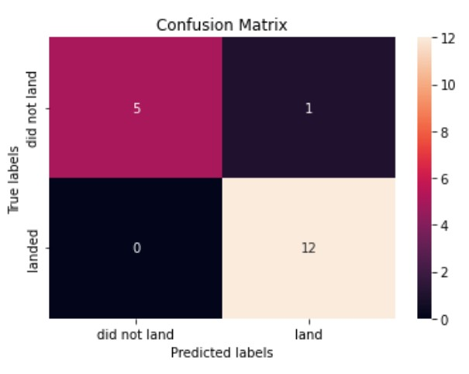
Confusion Matrix
True Positives: 12
True Negatives: 5
False Positives: 1
False Negatives: 0

Slide 48
Conclusions
Prediction with Logistic Regression is quite accurate
Support Vector Machine also provide a good result for predicting the
landing outcome
None of the models had false negatives
All models had at least one false positive

Slide 49
Appendix
All Python code and SQL can be inspected from the following links
GIT Hub

Slide 50


